Slide 1
DNA & RNA As Genetic Material
BY
Dr. K. Aruna
Assistant Professor
Department of Microbiology
1

Slide 2
It is well known fact that transmission of traits takes place from one generation to other. The offsprings are similar to both the parents in some traits
Gregor Johann Mendel (1866 ) on the basis of his hybridization experiments on Sweet pea gave the idea that transmission of traits over generations take place through Factor or Determiner or Gene which carries information for expression of trait or phenotype.
Genes are present on the chromosomes which are distributed equally into the two daughter cells during cell division. The biochemical studies reveal that chromosomes are composed of proteins (60% ) and DNA (40% )
2

Slide 3
Genetic material must be capable of
Replication ( Make its copy )
Storage of information for expression of trait
Control expression of traits
Change in controlled way (undergo mutation)
Must be stable
3

Slide 4
Is the Genetic Material Protein or DNA
Topic of Discussion till 1944 was which chromosomal component DNA or Protein carries hereditary information or is the genetic material
Untill 1940 Proteins were considered as genetic material as Proteins are polymer of 20 protein amino acids and present in larger quantity, encode more and variety of information.
DNA is polymer of only 4 different deoxyribonucleotides (ATP, CTP, GTP & TTP) and is present in smaller quantity
Most geneticists focused on “transmission genetics” and passively accepted proteins as the genetic material
4

Slide 5
But On the basis of certain experiments conducted from time to time ,it was ultimately demonstrated that DNA carries genetic information and not the proteins
There are some direct evidences and some indirect evidences which prove DNA as Genetic Material
Direct evidences come from :
Frederick Griffith’s (1928) experiment on Bacterial Transformation
Oswald Avery, Colin Macleod and Maclyn McCarty’s (1944 ) experiment on Transformation
Alfred D. Hershey and Martha Chase (1952 ) experiment on T- Even (2,4 ) Bacteriophage
5

Slide 6
Frederick Griffith (1928) Studied Diplococcus pneumoniae, having Two strains
SIII strain was virulent, possessed a lipopolysaccharide capsule and could kill mice by causing disease Pneumonia and made round colonies on a culture plate
RII strain was avirulent and lacked a Lipopolysaccharide (LPS) capsule, growing in rough–shaped colonies on a culture plate
6

Slide 7
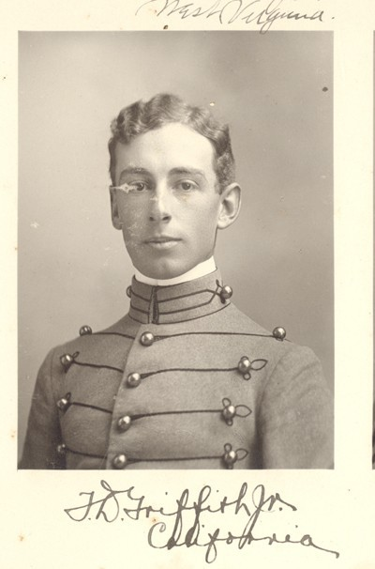
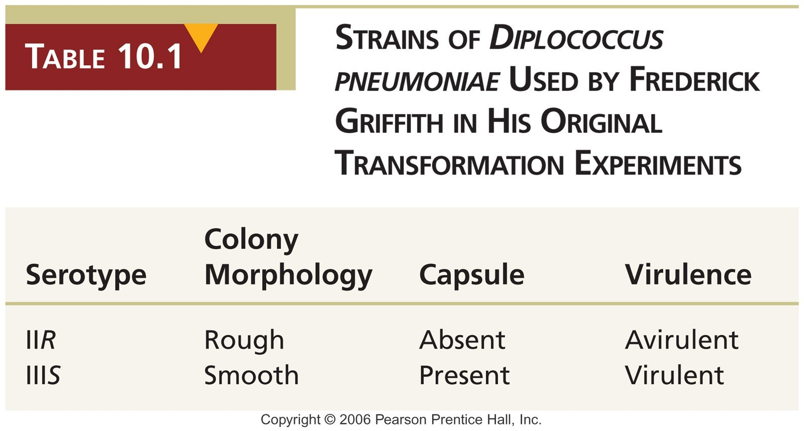
7

Slide 8
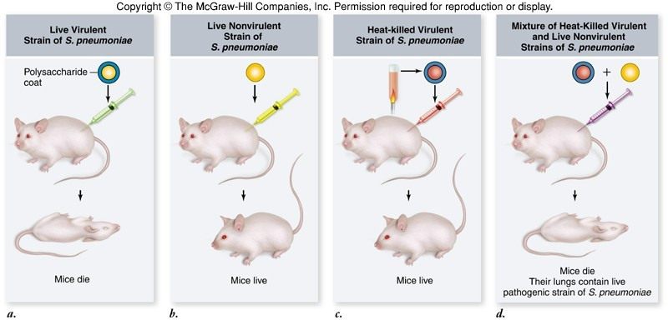
STEPS IN THE EXPERIMENT
1 LIVE 2
SIII
LIVE 3 H K S III RII
4 H K S III &
Strains of Diplococcus pneumoniae injected t⁸o mice
LIVE RII
21/08/2020

Slide 9
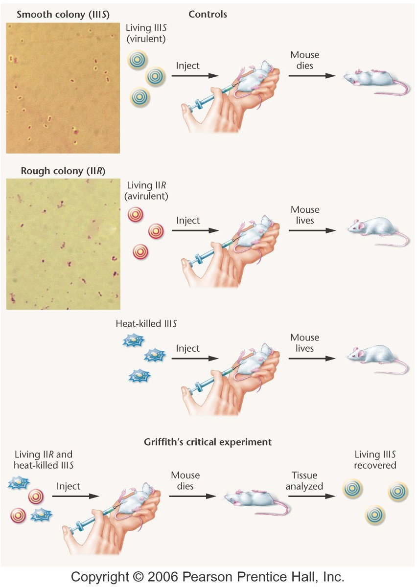
Griffith’s Experiment
1
RII →SIII
transformation takes place in step 4 give clue for DNA as
genetic material
2
3
4
9
06/19/13

Slide 10
STEPS AND RESULTS OF GRIFFITH’S EXPERIMENT
S N
I II III
STEPS
Mouse injected with SIII strain Mouse injected with RII strain Mouse injected with Heat Killed SIII strain
RESULT
Mouse died Mouse survived Mouse survived
√
IV
Mouse injected with Heat Killed SIII & Mouse died & from
living R II strain
its blood live SIII √
strain bacteria recovered Mouse survived
V
Mouse injected with Heat Killed SIII+ living RII strain + DNase enzyme
Mouse injected with Heat Killed SIII+ living RII strain + Protease enzyme
VI
Mouse died of √
Pneumonia
10
21/08/2020

Slide 11
GRIFFITH’S CONCLUSION
On the basis of Result of step IV Griffith concluded that there was transformation of Avirulent RII type to Virulent SIII type by picking up the genetic material encoding the LPS capsule from the Heat Killed S III .
This bacterial transformation clearly shows the role of DNA as Genetic Material and is further confirmed by results of step V which shows no transformation as DNase digests DNA and step VI again shows transformation as protease only digests protein

Slide 12
Avery, MacLeod, & McCarty, 1944 repeated Griffith’s
experiment of transformation concluded
using purified cell extracts and
Removal of all protein from the transforming material did not destroy its ability to transform R strain cells
DNA-digesting enzymes destroyed all transforming ability The transforming material is DNA

Slide 13
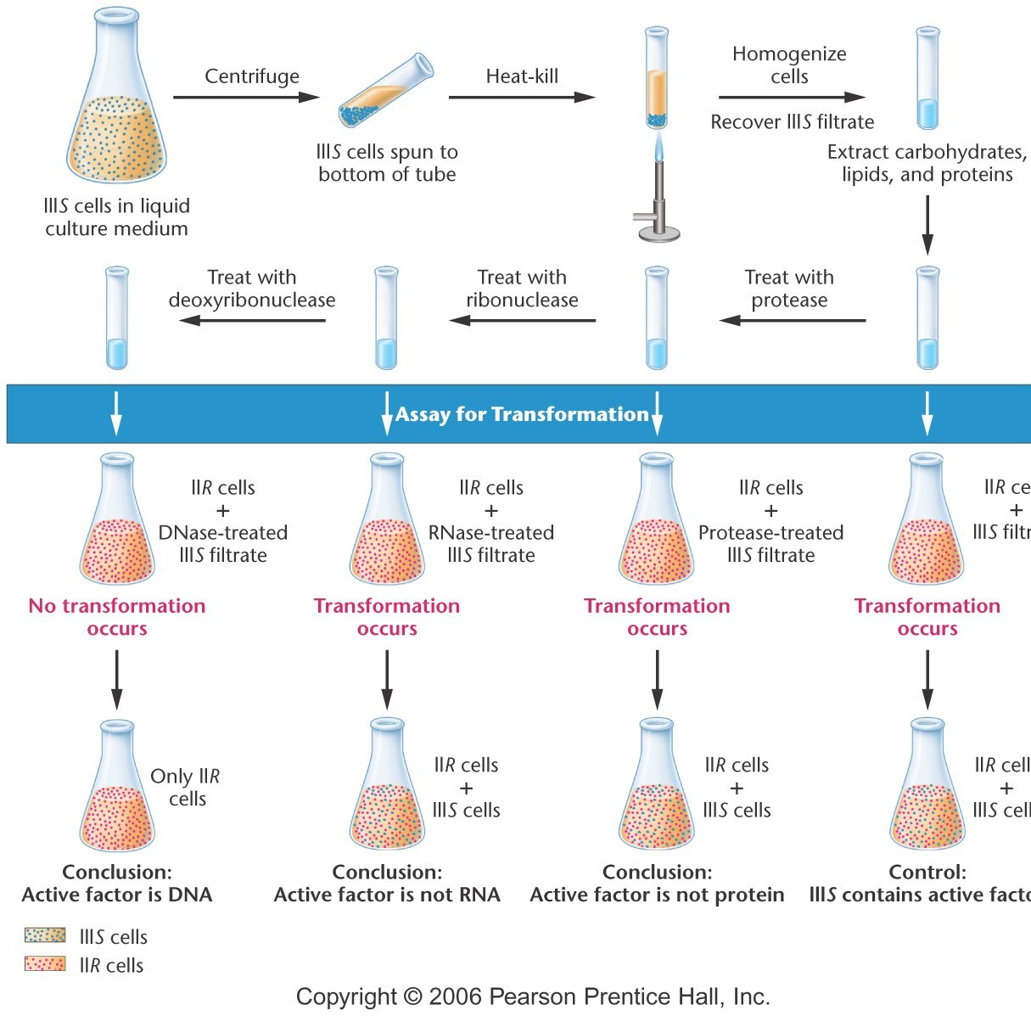
AVERY,M ACLEOD AND MCCART Y (1944)

Slide 14
Avery, MacLeod AND McCarty EXPERIMENT
❑
❑
Is based on transformation
Cell free extract of SIII strain Bacterium was subjected to DNase,RNase and Protease
❑ Each treated extract was mixed with RII and mixture injected to mouse to see transformation.
❑ In case of Protease and RNase transformation was recorded
❑ In case of DNase no transformation was recorded

Slide 15
Avery et al (1944) revealed the chemical nature of the transforming substance to be DNA. With the help of experiment they showed that DNA isolated from SIII strain Bacteria could confer the pathogenic properties to R II strain Bacteria .
Two conclusion were derived
1.Active factor is DNA which can cause transformation 2.SIII strain contains the Active factor

Slide 16
Hershey AND Chase Experiment
Alfred Hershey and Martha Chase, 1952 investigated bacteriophages : viruses that infect bacteria
the bacteriophage was composed of only DNA and protein
they wanted to determine which of these molecules is the genetic material that enters into the bacteria

Slide 17
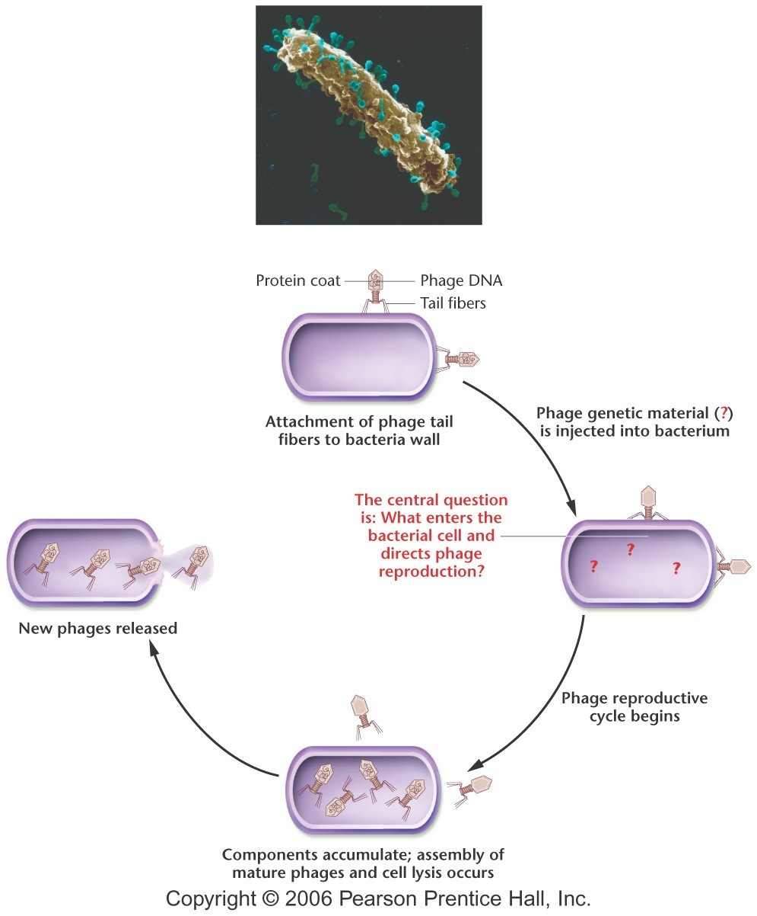
Life Cycle of T- 2 Phage
Phage is made of DNA and protein coat
Only DNA enters in the Bacterial cell and protein coat is left out side

Slide 18
EVENTS WHICH TAKE PLACE IN LIFE CYCLE OF BACTERIOPHAGE
Attachment of Bacteriophage to receptor site on bacterial cell wall by its tail
Bacterial cell wall dissolves at the point of contact
Phage DNA enters into Bacterial cell, protein coat remains outside
▪Phage DNA replicates forming many copies
▪Assembly of phage DNA into new protein shells
▪Lysis or breakdown of host cell and release of infective phage particle.

Slide 19
HERSHEY & CHASE (1952) EXPERIMENT WITH T2 BACTERIOPHAGE
In culture I Bacteriophage was grown in medium containing Radioactive Phosphorus (³²P))To make DNA Radioactive
In culture II Bacteriophage was grown in medium containing radioactive Sulphur (³⁵S) To make proteins Radioactive
Both kinds of Bacteriophage particles were allowed to infect Bacteria The infected bacteria were observed for radioactivity
Radioactive Phosphorus was found with bacterial cells
Radioactive Sulphur was not traced in bacterial cells ( Only in Ghosts)
Bacteriophage progeny carried only radioactive phosphorus and not radioactive sulphur

Slide 20
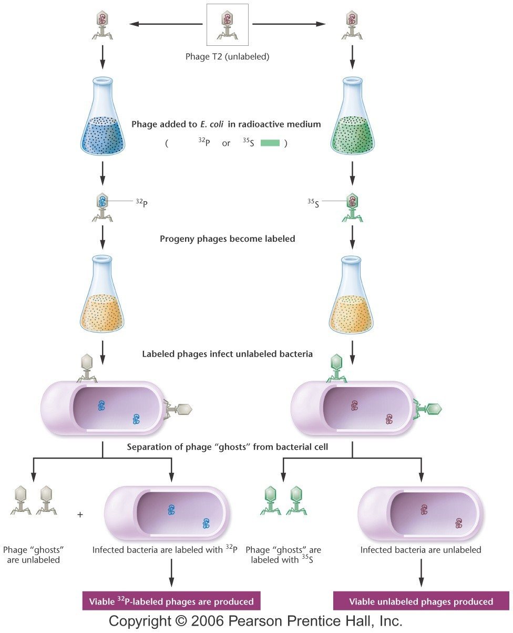

Slide 21
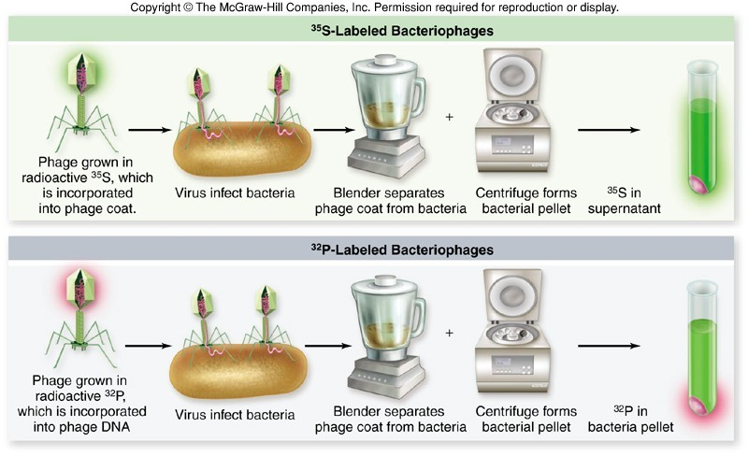

Slide 22
HERSHAY & CHASE CONCLUSION
As ghosts or coat of Bacteriophage were not labelled with 32P and only with 35S. The results of experiment clearly indicate that only DNA and not the proteins enter the bacterial cell. Protein coat is left outside. The DNA entering the host cell carries all the genetic information for synthesis of new phage particle. This certainly proves that DNA is the genetic material in Bacteriophage and not proteins

Slide 23
Summary of Hershey & Chase (1952 ) experiment
-
Bacteriophage DNA was labeled with radioactive phosphorus (³²P)
-
Bacteriophage protein was labeled with radioactive sulphur (³⁵S)
-
Radioactive molecules were tracked
-
only the bacteriophage DNA (as indicated by the ³²P) entered the bacteria and was used to produce more bacteriophage
Conclusion: DNA is the genetic material

Slide 24
SOME ORGANISMS HAVE RNA AS GENETIC MATERIAL
Some Viruses have RNA as Genetic Material
RNA Virus ( Ribo Virus ) may have ssRNA or dsRNA enveloped by Protein Coat
Notable human diseases caused by RNA viruses include SARS, Influenza ,Hepatitis C, Measels, Mumps and Rabies Rous Sarcoma Virus (causing cancer ) and HIV (causing AIDS) both are Retrovirus using Reverse Transcription for DNA synthesis in host cell

Slide 25
EXAMPLES OF PLANT RNA VIRUSES
Tobbaco Mosaic Virus (TMV ) was crystallized by Stanley (1935) for the first time
TMV causes Tobacco mosaic disease
TMV can also cause disease in Tomato, Pepper, Petunia, Snapdragon, Delphinium, and Marigold. Papaya Ring Spot virus (PRV)
Potato Leaf Roll Virus (PLRV) Holmesrib-grass Virus (HRV) –Plantago Alfa-alfa Mosaic Virus (AMV)

Slide 26
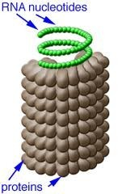
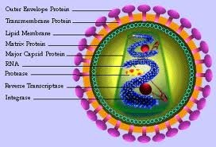
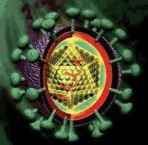
RNA VIRUSES
TMV
HIV
HEPATITES C VIRUS

Slide 27
EVIDENCE IN FAVOUR OF RNA AS GENETIC MATERIAL
A Gierer and G Schramm ( 1956 ) when inoculated tobacco plants with Purified RNA isolated from TMV - Leisons appeared on leaves of healthy plant
H Fraenkel Conrat and B Singer (1957) separated RNA from protein of TMV in first step .
In second step reconstituted virus with protein from mutant strain of TMV

Slide 28
Inoculated Hybrid TMV into healthy tobacco plant Tobacco Mosaic disease appeared
TMV progeny isolated from diseased plant showed parental RNA only but not parental proteins
This provided evidence that RNA carries information for assembly of Virus particles and not proteins
RNA thus is the Genetic Material in TMV
31
21/08/2020

Slide 29
SUMMARY OF THE PRESENTAION ON DNA AS GENETIC MATERIAL
Gene (Mendelian Factor) carries information for expression of Phenotype
Genes are present on chromosomes
The chromosomes contain 60% protein and 40% DNA Genetic Material must be stable, capable of replication, storing information for expression and undergo mutation

Slide 30
Expression is controlled through Central Dogma of Molecular Biology involving Replication,Transcription and Translation
Results of Experiments performed by Griffith’s (1928), Avery et al (1944) and Hershey and Chase (1952) provide direct evidences in favour of DNA as Genetic Material
There are some indirect evidences also in favour of DNA as Genetic Material
In some organisms RNA is the Genetic Material Evidences are given by Experiments on TMV

Slide 31
THE MODERN FRAME WORK OF MOLECULAR BIOLOGY
Transcription
Processing
Translation
DNA
preRNA
RNA
Replication & Repair
Protein
DNA
Folding Assembly Processing
Central Dogma

Slide 32
